Slide 1


Proposal for Automating Academic Research Solution.
Our biotechnology company has developed a new medical device concept.
To scientifically prove its feasibility, a research team seeks an automated search solution to streamline the online academic research process.
This proposal outlines an end-to-end solution to improve the research workflow created by our technical team.
Source: Freepik

Slide 2




Proposal for Automating Academic Research Solution.
Problem Statement
The current manual approach poses significant
challenges and limitations:
time-consuming
susceptible to errors
Technical Team
Software Consultants:
Elena Mendes Edwards
Kazuma Hazebayashi
Agent Design Specialist:
Anastasia Rizzo
Agent Development Specialist:
Samuel Adeniyi
Proposed Solution Overview
A comprehensive and integrated system to:
automate research tasks,
employ advanced algorithms, and
improve overall efficiency, accuracy, and productivity.

Slide 3
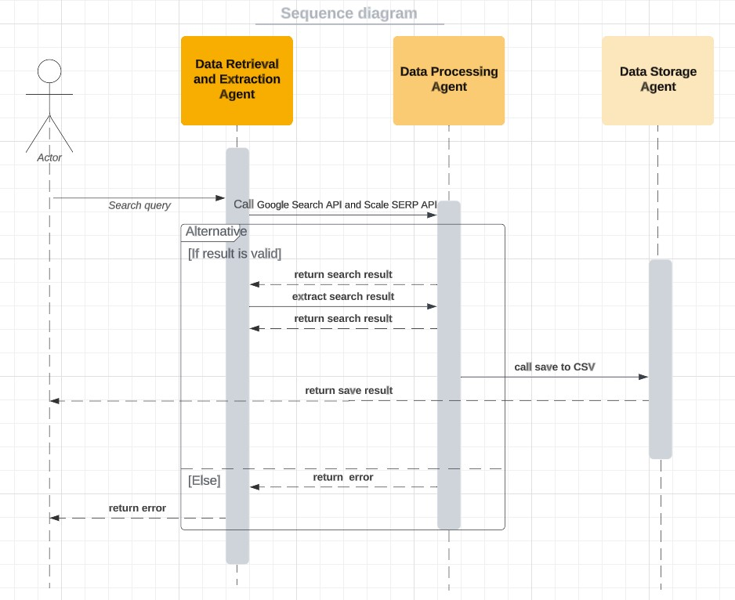
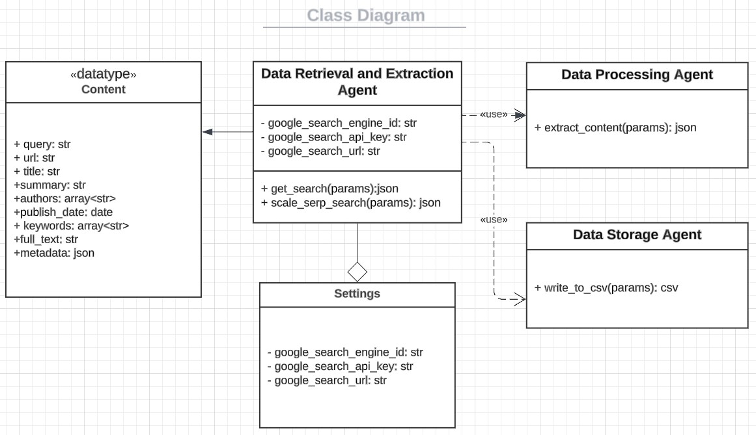
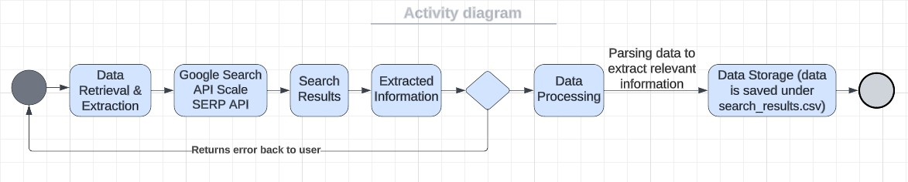
Proposal for Automating Academic Research Solution.
Solution Design

Slide 4
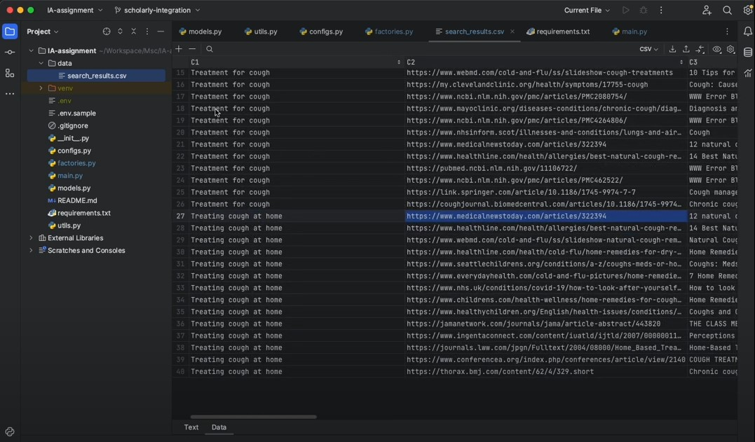
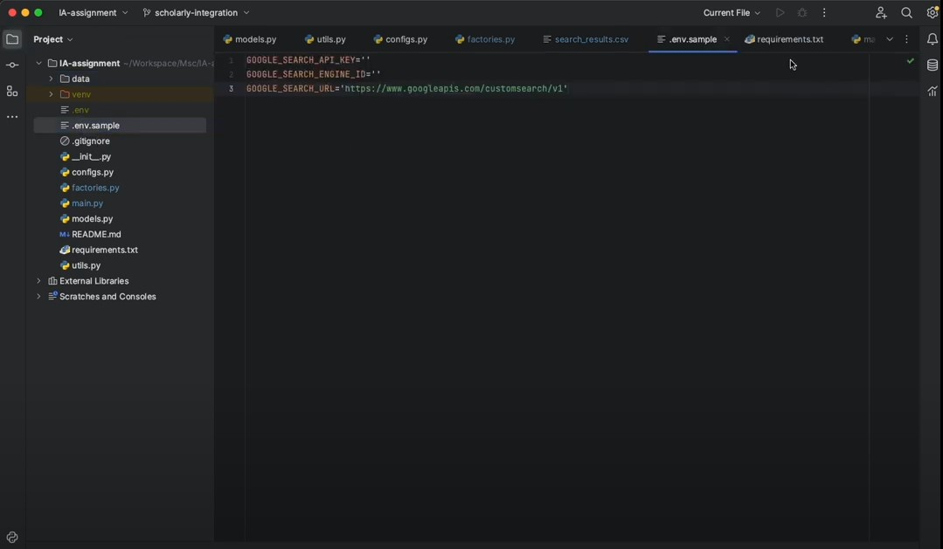
Proposal for Automating Academic Research Solution.
Solution Implementation
Picture 1.
Picture 2.

Slide 5
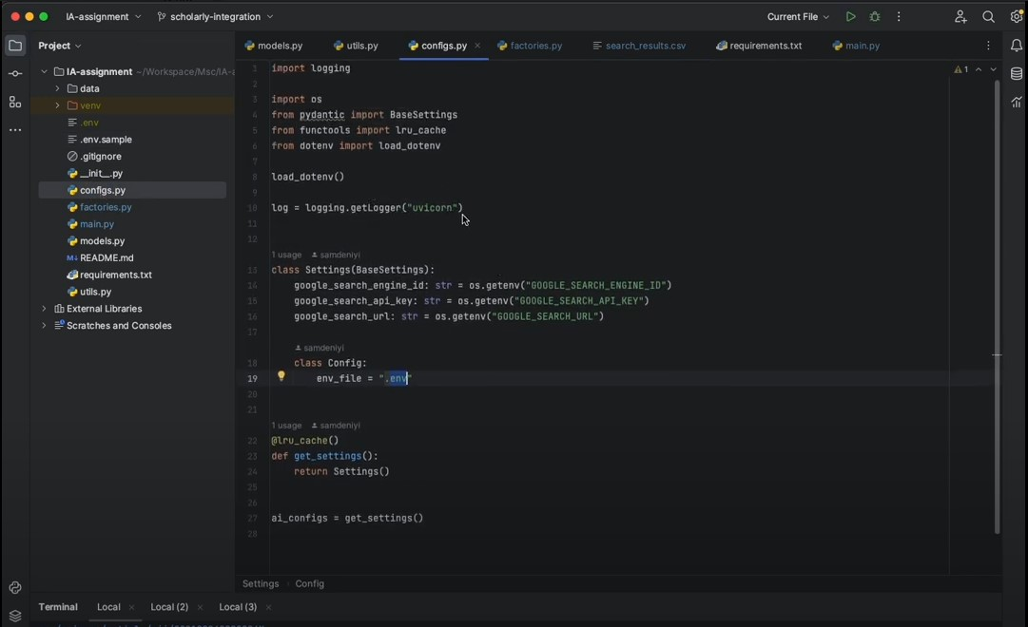
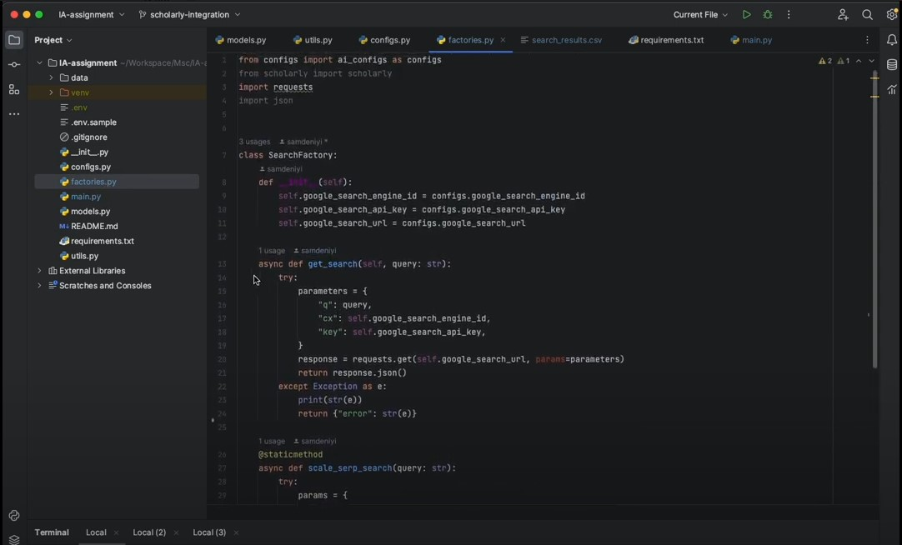
Proposal for Automating Academic Research Solution.
Solution Implementation
Picture 3.
Picture 4.

Slide 6
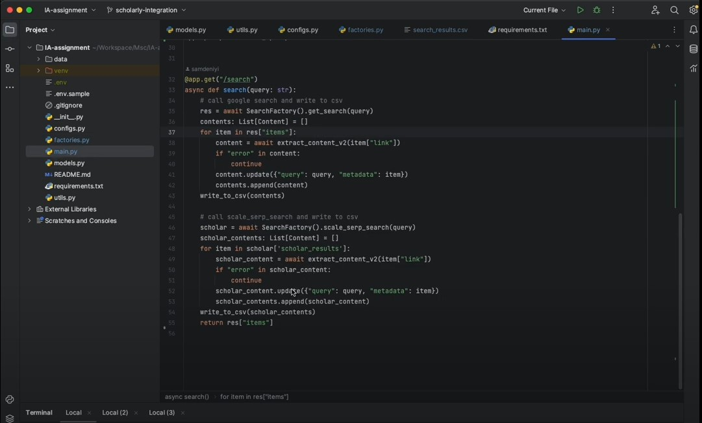
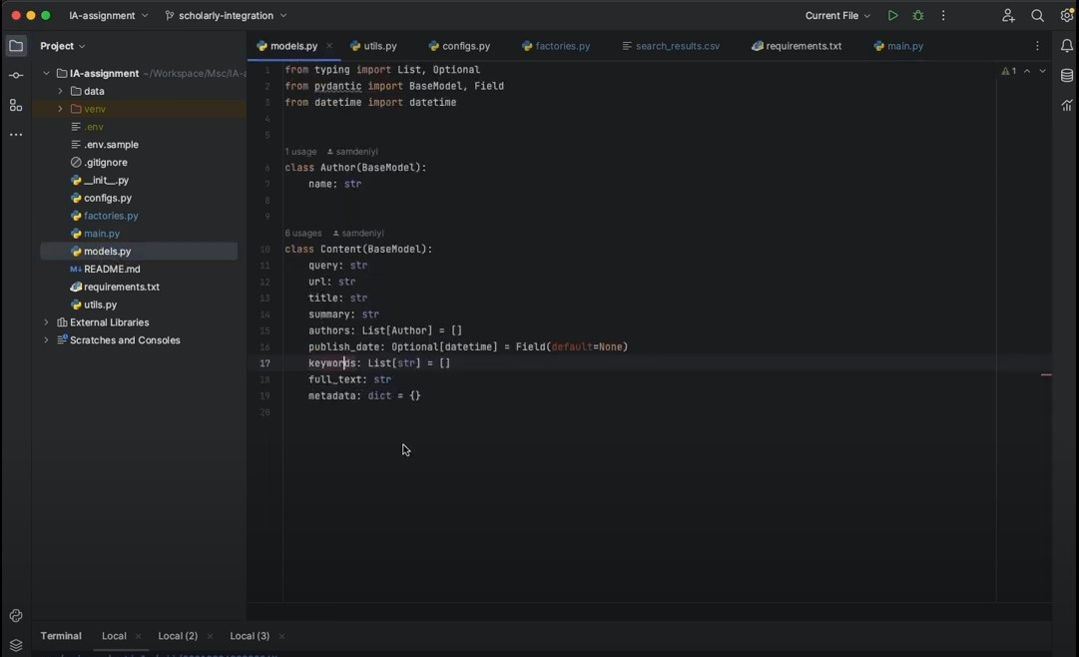
Proposal for Automating Academic Research Solution.
Solution Implementation
Picture 5.
Picture 6.

Slide 7
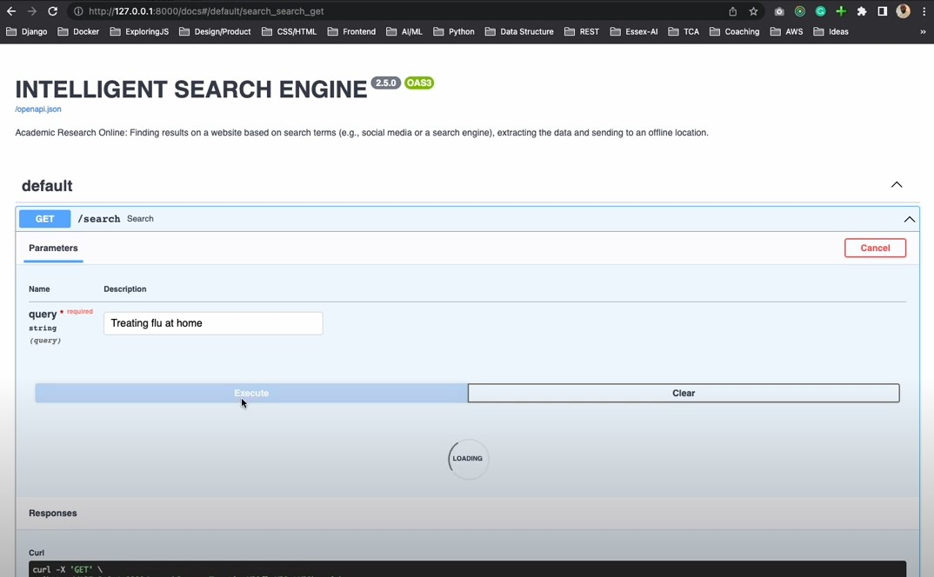
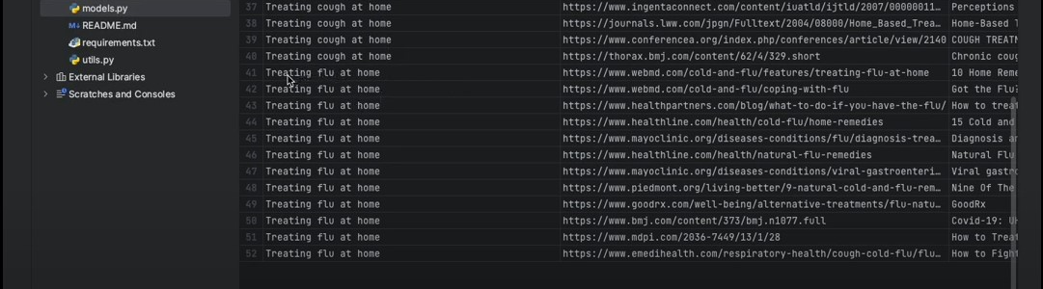
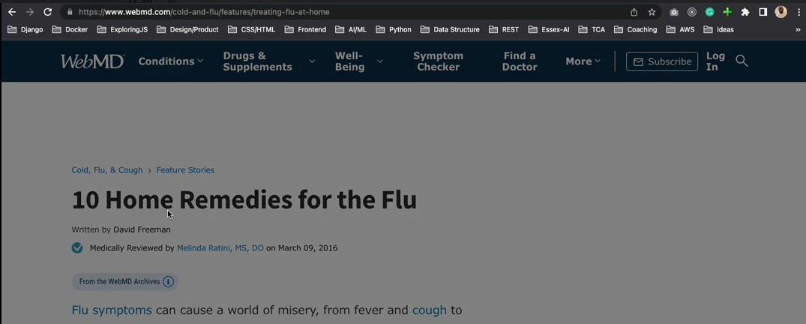
Proposal for Automating Academic Research Solution.
Solution Implementation
Picture 7.
Picture 8.
Picture 9.

Slide 8
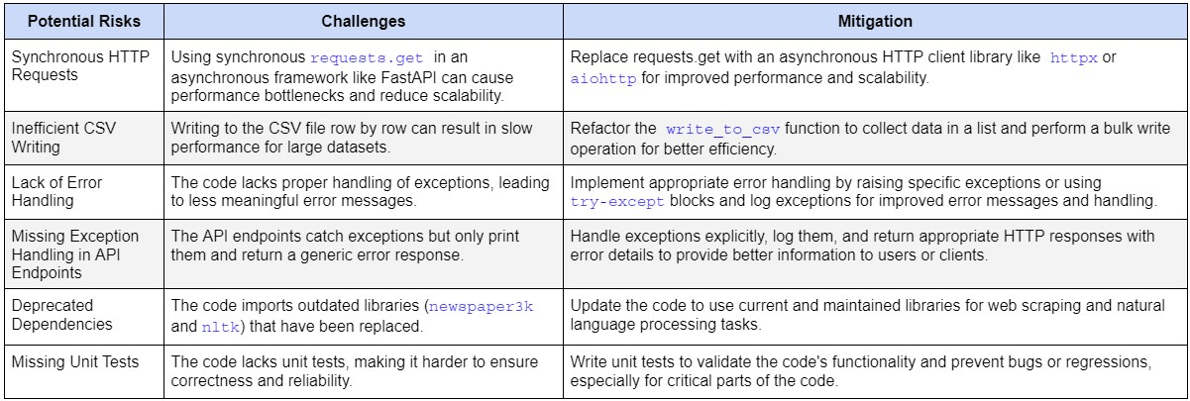
Proposal for Automating Academic Research Solution.
Risk Assessment

Slide 9
Proposal for Automating Academic Research Solution.
Justification and Benefits
Improved Efficiency
Intelligent Data Processing
Modularity and Scalability
Enhanced Collaboration
Structured Data Storage and Access

Slide 10
Proposal for Automating Academic Research Solution.
References
Adeniyi, S. (2023) Explainer Video Script for Team, 14 July.
Bansall S. (2023) Agents in Artificial Intelligence. Available from: https://www.geeksforgeeks.org/agents-artificial-intelligence [Accessed 08 June 2023].
Elise J. (2020) Handling Errors in Python. Available from: https://betterprogramming.pub/handling-errors-in-python-9f1b32952423 [Accessed 08 June 2023].
IBM (2023) Test-driven development. Available from:
https://www.ibm.com/garage/method/practices/code/practice_test_driven_development/ [Accessed 08 June 2023].
Microsoft (2023) Best practices for exceptions. Available from:
https://learn.microsoft.com/en-us/dotnet/standard/exceptions/best-practices-for-exceptions [Accessed 08 June 2023].
Mozilla (2023) Introducing asynchronous JavaScript. Available from: https://developer.mozilla.org/en-US/docs/Learn/JavaScript/Asynchronous/Introducing [Accessed 08 June 2023].
Russell, S. & Norvig, P. (2021) Artificial Intelligence: A Modern Approach. (4th ed). Pearson Education.
Shah, U.S. et al.(2022) Agent-Based Data Extraction in Bioinformatics. Hindawi. Available from: https://www.researchgate.net/publication/359500106_Agent-Based_Data_Extraction_in_Bioinformatics [Accessed 08 June 2023].
Wooldridge, M. J. (2009) An introduction to multiagent systems. (2nd ed). New York: John Wiley & Sons.

